Slide 1
DATA STRUCTURES & ALGORITHMS

Slide 2
CONTENTS
Why are Arrays?
Arrays Operations.
Binary Search.
Linear Search.

Slide 3
01
What are Arrays?

Slide 4
What are Arrays?
An array data structure is a fundamental concept in computer science that stores a collection of elements in a contiguous block of memory.
Array is a linear data structure that stores a collection of items of same data type in contiguous memory locations. Each item in an array is indexed starting with 0. We can directly access an array element by using its index value.

Slide 5
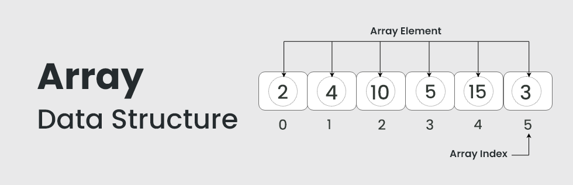
What are Arrays?

Slide 6
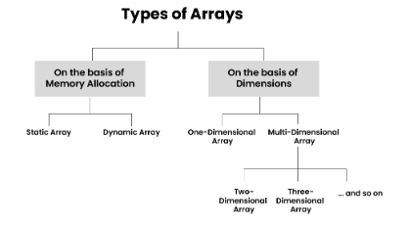
What are Arrays?

Slide 7
02
Arrays Operations

Slide 8
Arrays Operations
Traversal: Visiting each element of an array in a specific order (e.g., sequential, reverse).
Insertion: Adding a new element to an array at a specific index.
Deletion: Removing an element from an array at a specific index.
Searching: Finding the index of an element in an array.

Slide 9
03
Binary Search.

Slide 10
Binary Search
Binary search is the search technique that works efficiently on sorted lists. Hence, to search an element into some list using the binary search technique, we must ensure that the list is sorted.
Binary search follows the divide and conquer approach in which the list is divided into two halves, and the item is compared with the middle element of the list. If the match is found then, the location of the middle element is returned. Otherwise, we search into either of the halves depending upon the result produced through the match.

Slide 11
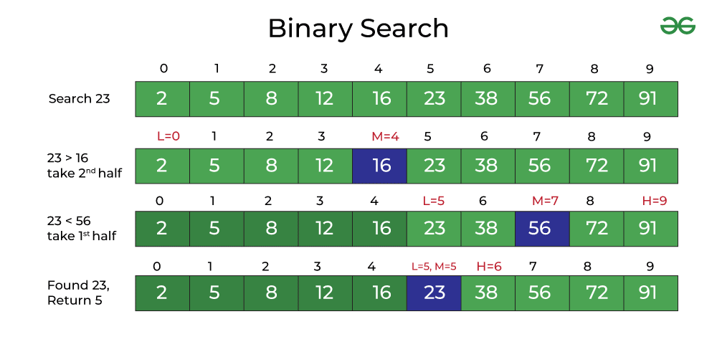
Binary Search

Slide 12
04
Linear Search.

Slide 13
Linear Search
Linear Search is defined as a sequential search algorithm that starts at one end and goes through each element of a list until the desired element is found, otherwise the search continues till the end of the data set.

Slide 14
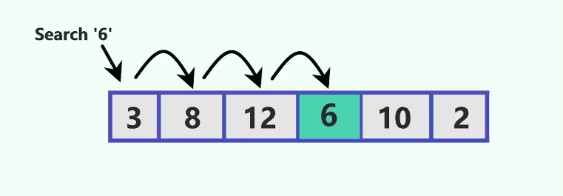
Linear Search

Slide 15
THANKS

